Slide 1
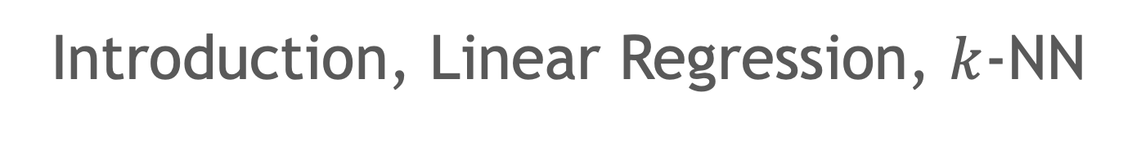
Machine Learning
Introduction, Linear Regression, $k$-NN

Slide 2
Unit V: Machine Learning
Machine Learning: Linear and non-linear regression, supervised learning – neural network, binary decision diagram, SVM, k-NN, unsupervised learning – Clustering, Hidden Markov Models, Introduction to deep learning

Slide 3
Data Science
Data science involves
defining the problem,
design the data set in domain of the problem,
prepare the data,
decide on the type of data analysis to apply, and
evaluate and interpret the results of the data analysis.
The role of computer in data science is
the ability to process data faster and
search for patterns (frequent as well as rare) in the data.

Slide 4
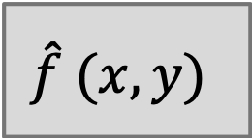
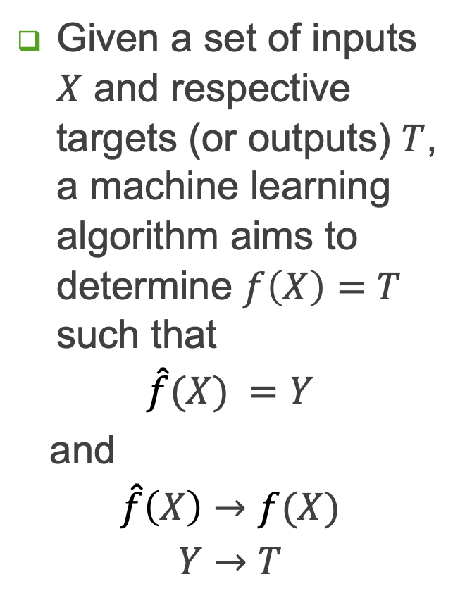



Machine Learning
Given a set of inputs $X$ and respective targets (or outputs) $T$, a machine learning algorithm aims to determine $f\left(X\right)=T$ such that
$$\hat{f}(X) =Y$$
and
$$\hat{f}\left(X\right)→f(X)$$
$$Y→T$$
$$X=\{x_{1},x_{2},…,x_{N}\}$$
$$\hat{f} (x, y)$$
$$T=\{t_{1},t_{2},…,t_{N}\}$$
$$T=\{t_{1},t_{2},…,t_{N}\}$$

Slide 5
Machine Learning
Machine learning (ML) is the field of computer science that develops the algorithms to identify and extract patterns from data.
ML algorithm is applied to a data set to identify useful patterns in the data.
These patterns can be represented in a number of different ways.
Regression models, Neural networks, Decision trees, SVM (support vector machines) etc.
representations of patterns also called “models,”
ML algorithms
﻿automate the process of learning a model that captures the relationship between the descriptive features and the target feature in a dataset. ¹
create models from data, and each ML algorithm designed to create models using a particular representation (neural network or decision tree or other).
once a model has been created, it is used for analysis.
Model
structure of the model is important if it reveals important attributes. For example, factors responsible for virus infection
in other cases, a model is used to label or classify new examples. For instance, spam-filter modellabels emails as safe or spam.

Slide 6
Machine Learning: ill-posed problem
﻿ML algorithms search through a set of possible models to find the model that best captures the relationship between the features and target in a training dataset.
So model parameters are largely decided by training set. If training set does not capture population characteristics, learning model shall not be as accurate.
Why is ML an ill-posed problem?
Acquisition of dataset can not be free of noise.
the training set represents only a small sample of the all possible instances in the domain. Or in other words, this set does not contain an instance for every possible combination of feature-target value.
As a result, machine learning is an ill-posed problem i.e. a problem for which a unique solution cannot be arrived at with help of only the available information.
For a learning model is to be useful, it should be able to estimate target correctly even for queries not present in the training data. A model that makes the correct estimations in almost all cases captures the underlying relationship between the features and target. Such a model is said to generalize well.
ML Objective: to find the model that generalizes best.

Slide 7
ML Problems
Underfitting
Model is inadequate to represent relationship between features and target.
Underfitting occurs when the selected model is too simple.
For example: using a line to model a cubic curve
Overfitting.
Model selected is complex.
Overfitting occurs when the selected model fits to the training dataset too closely.
Overfitting makes model sensitive to noise and even legitimate variations in the data. Such a model does not generalize well.

Slide 8
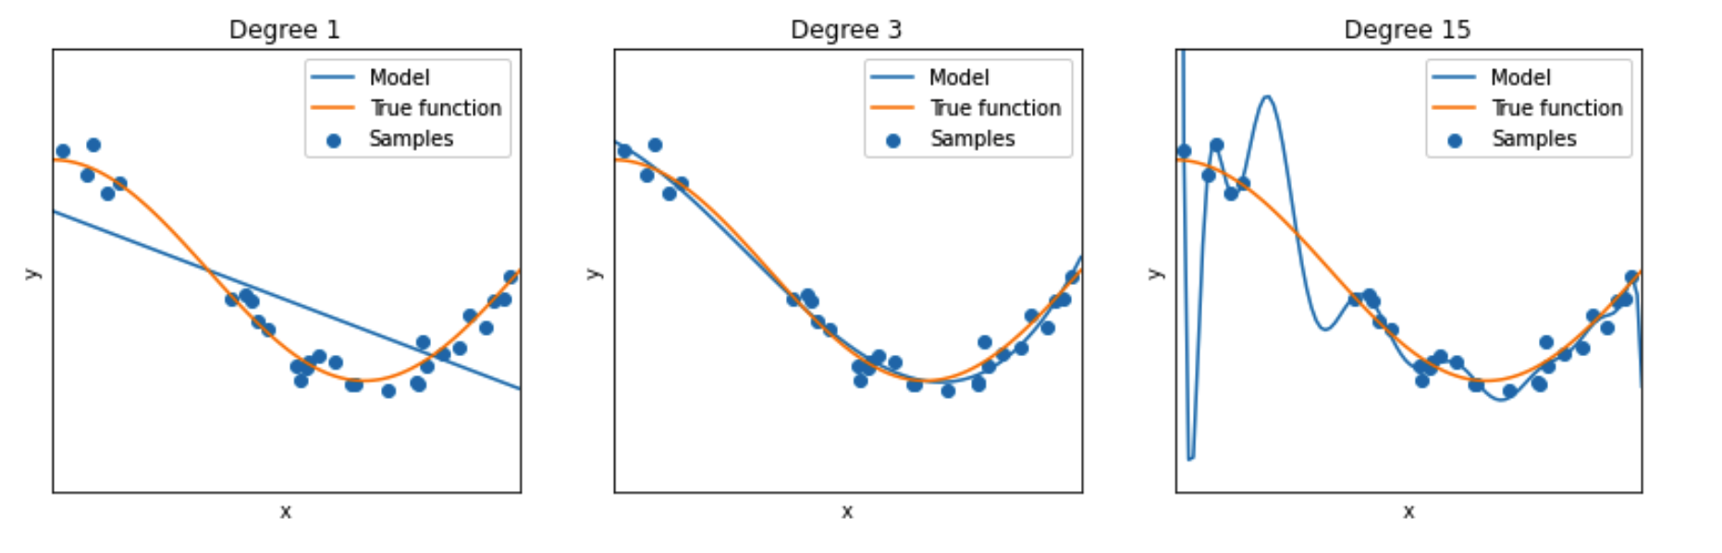
Underfitting, Overfitting

Slide 9
Machine Learning
ML algorithms can be classified as
supervised learning or
unsupervised learning.
Supervised learning
Explores different functions to find the function that best maps the inputs to output.
Unsupervised learning
However, for any data set of reasonable complexity there are so many combinations of inputs and possible mappings to outputs that an algorithm cannot try all possible functions. As a consequence, each ML algorithm is designed to look at or prefer certain types of functions during its search. These preferences are known as the algorithm’s learning bias.
﻿

Slide 10
Supervised Learning
Supervised learning
aims to determine function that best maps inputs to outputs
for a data set, there are many combinations of inputs and possible mappings
For a data set of reasonable complexity, a ML algorithm can not exhaustively explore all possible functions.
Each ML algorithm is designed to explore certain types of functions during its search. These preferences are known as the algorithm’s learning bias.
Each instance needs to be labelled with the target value.
Creation of a labelled dataset is time consuming.

Slide 11
Unsupervised Learning – 1/2
Does not require labelled data set and there is no target attribute.
Most commonly used method is cluster analysis,
Underlying hypothesis is that similar data are grouped together in feature space; distance/similarity metric can be used to identify data patterns
A cluster should contain instances that are more similar to each other than they are to other instances in the data.
Clustering algorithm should aim to increase intra-cluster (within cluster) similarity and inter-cluster (across clusters) diversity.
Not having a target attribute makes learning more difficult:
Means no time and effort needed for labelling instances.
instead of the specific problem of searching for a mapping, the algorithm has more general task of searching for regularities in the data.

Slide 12
Unsupervised Learning – 2/2
Clustering algorithm l
A cluster should contain instances that are more similar to each other than they are to other instances in the data.
Initially, start with a random set of clusters
Iteratively update clusters (moving instances from one cluster to another) to increase intra-cluster (within cluster) similarity and inter-cluster (across clusters) diversity.
Challenges to clustering
Identifying metric for similarity.
If all attributes are numeric and have similar ranges, Euclidean distance (straight-line distance) is a good choice.
Normalization is needed if different numeric attributes have different ranges; otherwise “equidistant” points may not actually belong to same cluster
If some attributes are more important than others, so attributes need to be weighted before application of distance metric. Question is how to identify these attributes?

Slide 13
ML: Predictive Model
Prediction: estimating the value of a target for a given instance based on the values of input attributes
ML algorithms generate prediction models.
Prediction models are based on
correlation analysis
linear-regression models
neural networks and
decision trees.

Slide 14
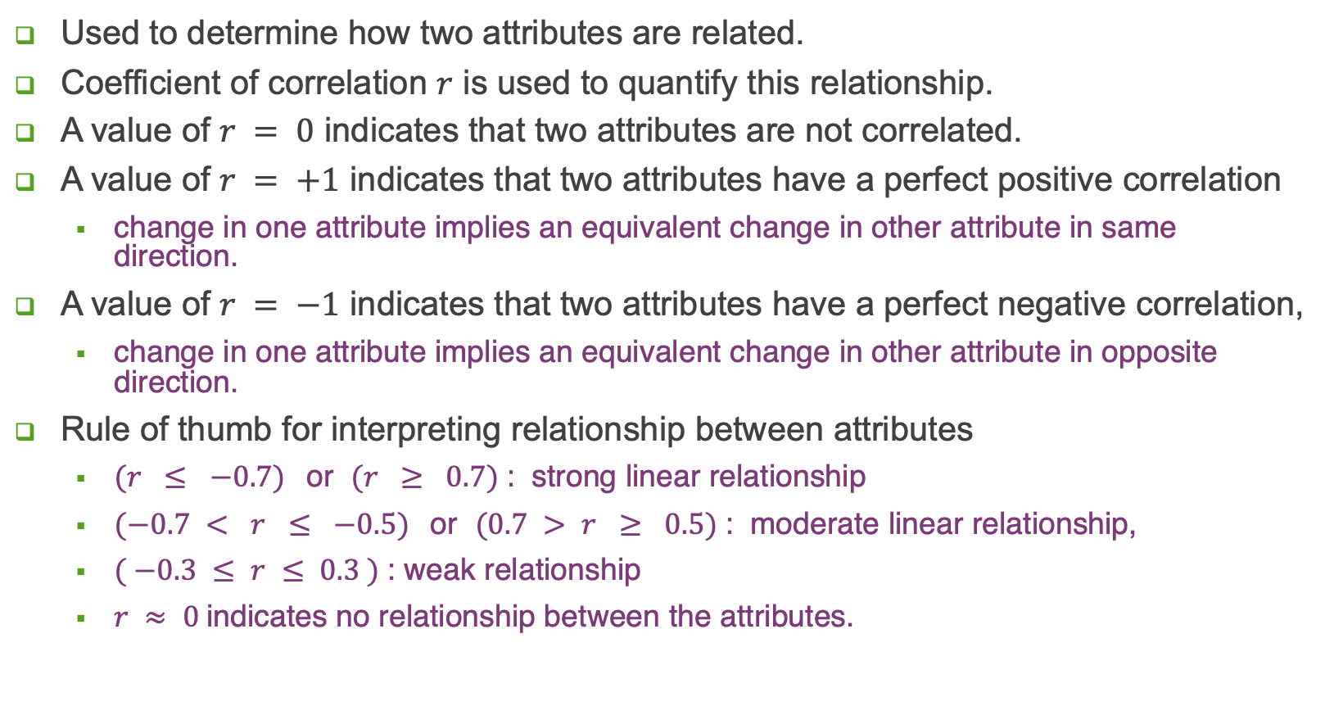
Correlation Analysis
Used to determine how two attributes are related.
Coefficient of correlation $r$ is used to quantify this relationship.
A value of $r = 0$ indicates that two attributes are not correlated.
A value of $r = +1$ indicates that two attributes have a perfect positive correlation
change in one attribute implies an equivalent change in other attribute in same direction.
A value of $r = −1$ indicates that two attributes have a perfect negative correlation,
change in one attribute implies an equivalent change in other attribute in opposite direction.
Rule of thumb for interpreting relationship between attributes
$(r ≤ −0.7)$or $(r ≥ 0.7)$: strong linear relationship
$(−0.7 < r ≤ −0.5)$or $(0.7 > r ≥ 0.5)$: moderate linear relationship,
$( −0.3 ≤ r ≤ 0.3 )$: weak relationship
$r ≈ 0$indicates no relationship between the attributes.

Slide 15
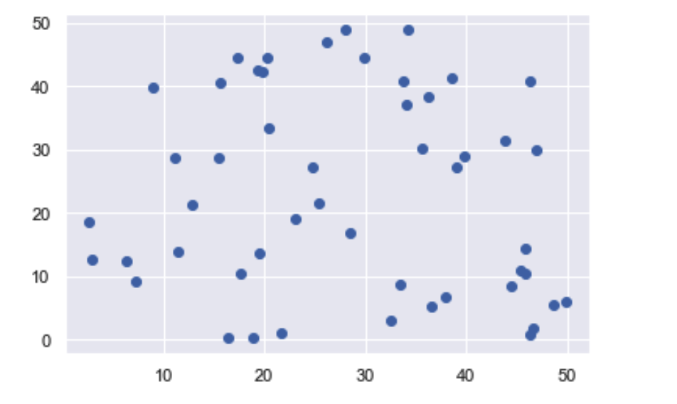
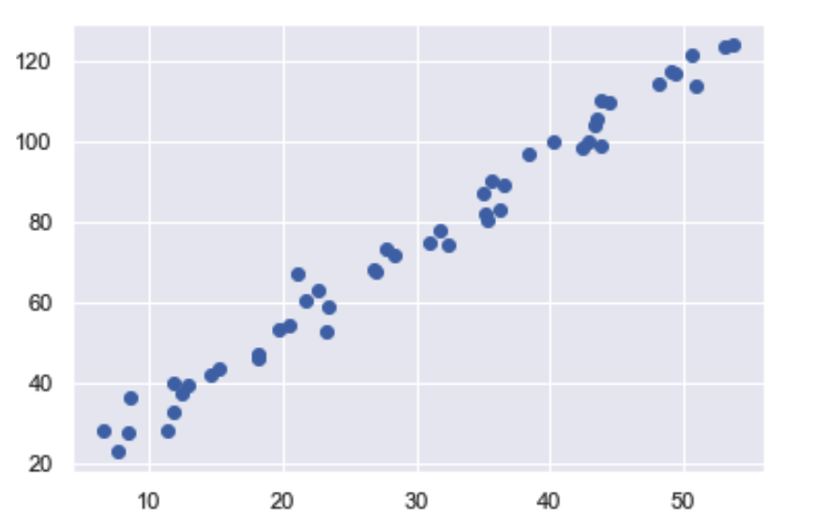
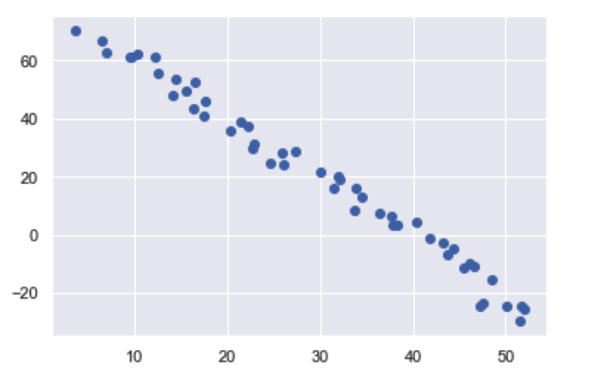
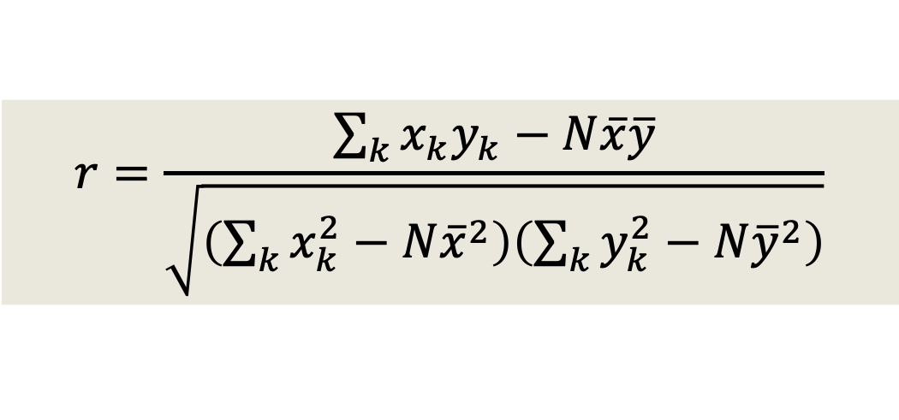
Correlation
Un-correlated Data
$$r=\frac{\sum_{k}{x_{k}y_{k}−N\overline{x}\overline{y}}}{\sqrt{\left(\sum_{k}{x_{k}^{2}−N{\overline{x}}^{2}}\right)\left(\sum_{k}{y_{k}^{2}−N{\overline{y}}^{2}}\right)}}$$
Positively Correlated Data
Negatively Correlated Data

Slide 16
Correlation: Attribute relevance
Correlation analysis used for
Relevance of attributes: feature selection and dimensionality reduction
Similarity metric: clustering
To determine mapping from the values of a set of input attributes to a target attribute,
There must be a correlation between the input attributes (or features) and the target attribute.
If this correlation does not exist (or cannot be found by the algorithm), then the input attributes are irrelevant for the prediction problem, and the best a model can do is to ignore those input attributes and always predict the central tendency of that target in the data set.

Slide 17
Regression
﻿Regression analysis aims to estimate the mapping from input to output through a parameterized function f called regression function: output = f (input)
Regression function
Analogous to a machine that converts inputs to an output value and its behavior is controlled by the parameters.
Objective of regression analysis is to determine the correct settings of multiple parameters.
May be linear or non-linear
﻿Linear-regression
Output is assumed to be linearly related to input i.e. linear combination of input.
Y = W₁X + W₀, W₀ and W₁ are parameters.
For a 2D data, this defines a line with W1 being the slope and W0 being the intercept.
For nD data, it is a hyperplane.
Setting the parameters of a regression function is equivalent to searching for the line that best fits the data.

Slide 18
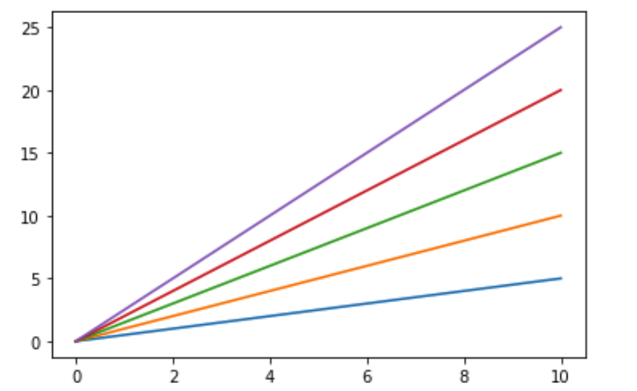
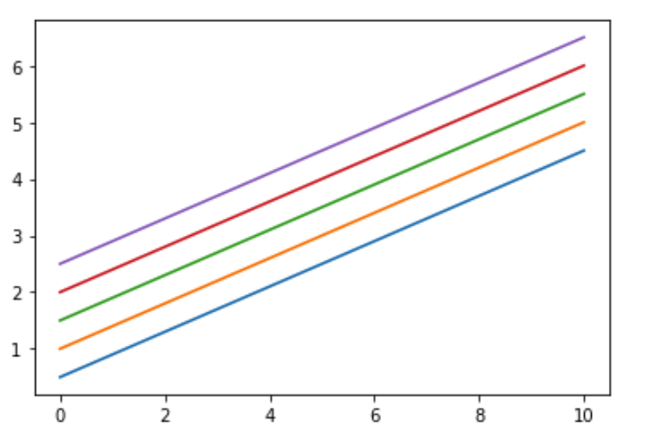



Linear Regression
Relationship between output and input is linear.
Can be expressed as
$$Y = W1X + W0$$
$W1$ increasing from blue to purple.
$W0$ increasing from blue to purple.

Slide 19
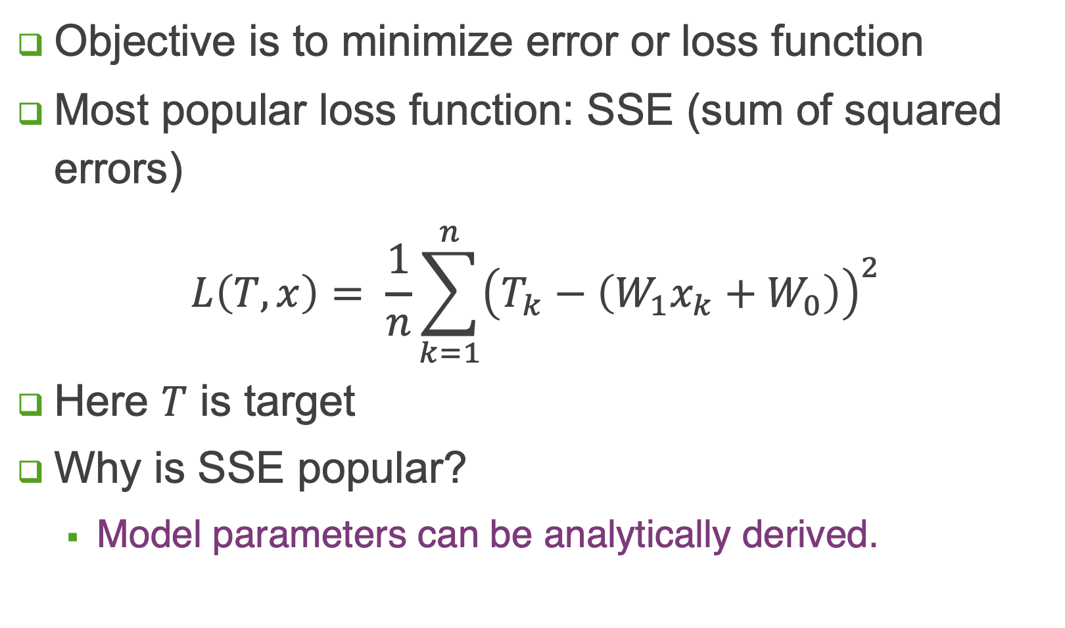
Linear Regression
Objective is to minimize error or loss function
Most popular loss function: SSE (sum of squared errors)
$$L\left(T, x\right)= \frac{1}{n}\sum_{k=1}^{n}{{\left(T_{k}−\left(W_{1}x_{k}+W_{0}\right)\right)}^{2}}$$
Here $T$ is target
Why is SSE popular?
Model parameters can be analytically derived.

Slide 20

$$f\left(x, w_{0}, w_{1}\right)=w_{0}+w_{1}x$$

Slide 21
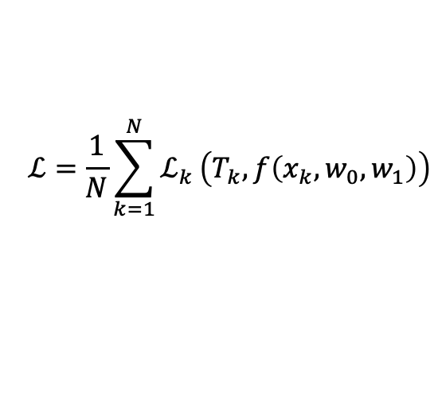
$$ℒ=\frac{1}{N}\sum_{k=1}^{N}{ℒ_{k}}\left(T_{k}, f\left(x_{k},w_{0}, w_{1}\right)\right)$$
$$f\left(x, w_{0}, w_{1}\right)=w_{0}+w_{1}x$$

Slide 22
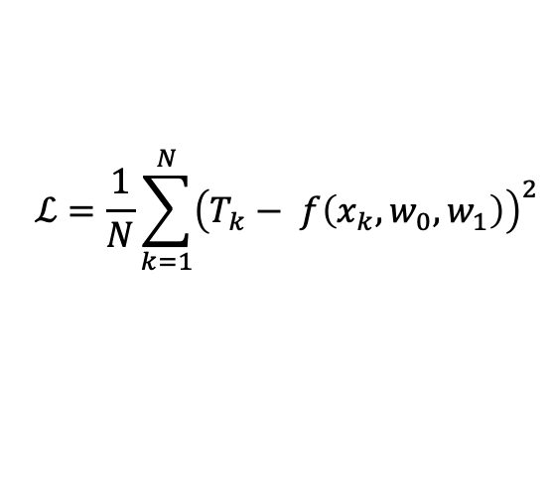
$$ℒ=\frac{1}{N}\sum_{k=1}^{N}{ℒ_{k}}\left(T_{k}, f\left(x_{k},w_{0}, w_{1}\right)\right)$$
$$f\left(x, w_{0}, w_{1}\right)=w_{0}+w_{1}x$$
$$ℒ=\frac{1}{N}\sum_{k=1}^{N}{{\left(T_{k}− f\left(x_{k},w_{0}, w_{1}\right)\right)}^{2}}$$
SSE applied

Slide 23
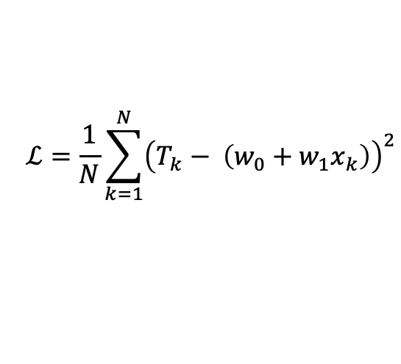
$$ℒ=\frac{1}{N}\sum_{k=1}^{N}{ℒ_{k}}\left(T_{k}, f\left(x_{k},w_{0}, w_{1}\right)\right)$$
$$f\left(x, w_{0}, w_{1}\right)=w_{0}+w_{1}x$$
$$ℒ=\frac{1}{N}\sum_{k=1}^{N}{{\left(T_{k}− f\left(x_{k},w_{0}, w_{1}\right)\right)}^{2}}$$
$$ℒ=\frac{1}{N}\sum_{k=1}^{N}{{\left(T_{k}− \left(w_{0}+w_{1}x_{k}\right)\right)}^{2}}$$

Slide 24
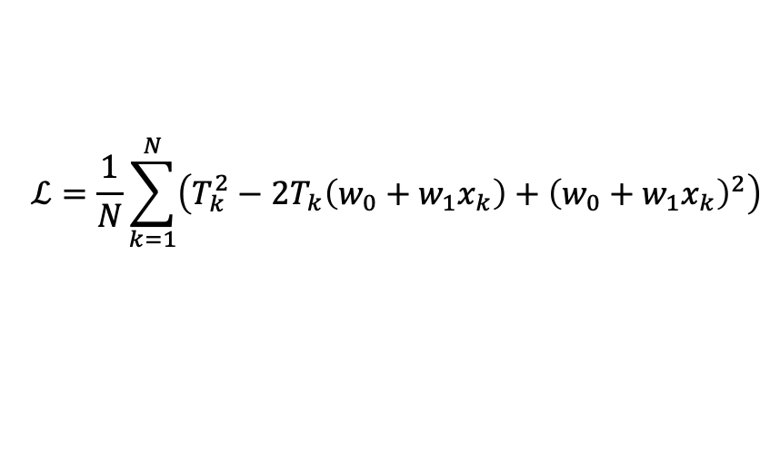
$$ℒ=\frac{1}{N}\sum_{k=1}^{N}{ℒ_{k}}\left(T_{k}, f\left(x_{k},w_{0}, w_{1}\right)\right)$$
$$f\left(x, w_{0}, w_{1}\right)=w_{0}+w_{1}x$$
$$ℒ=\frac{1}{N}\sum_{k=1}^{N}{{\left(T_{k}− f\left(x_{k},w_{0}, w_{1}\right)\right)}^{2}}$$
$$ℒ=\frac{1}{N}\sum_{k=1}^{N}{{\left(T_{k}− \left(w_{0}+w_{1}x_{k}\right)\right)}^{2}}$$
$$ℒ=\frac{1}{N}\sum_{k=1}^{N}{\left({T_{k}^{2}−2T_{k}\left(w_{0}+w_{1}x_{k}\right)+\left(w_{0}+w_{1}x_{k}\right)}^{2}\right)}$$

Slide 25
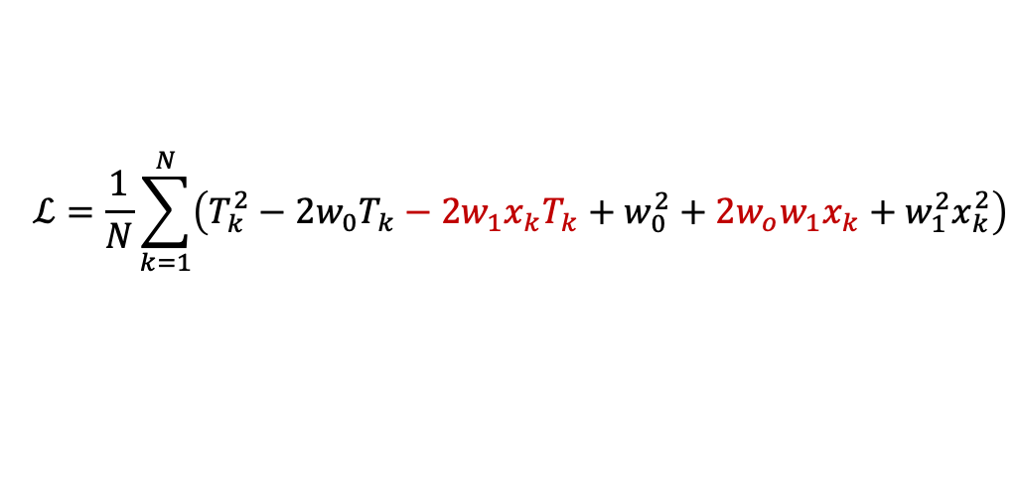
$$ℒ=\frac{1}{N}\sum_{k=1}^{N}{ℒ_{k}}\left(T_{k}, f\left(x_{k},w_{0}, w_{1}\right)\right)$$
$$f\left(x, w_{0}, w_{1}\right)=w_{0}+w_{1}x$$
$$ℒ=\frac{1}{N}\sum_{k=1}^{N}{{\left(T_{k}− f\left(x_{k},w_{0}, w_{1}\right)\right)}^{2}}$$
$$ℒ=\frac{1}{N}\sum_{k=1}^{N}{{\left(T_{k}− \left(w_{0}+w_{1}x_{k}\right)\right)}^{2}}$$
$$ℒ=\frac{1}{N}\sum_{k=1}^{N}{\left({T_{k}^{2}−2T_{k}\left(w_{0}+w_{1}x_{k}\right)+\left(w_{0}+w_{1}x_{k}\right)}^{2}\right)}$$
$$ℒ=\frac{1}{N}\sum_{k=1}^{N}{\left(T_{k}^{2}−2{w_{0}T}_{k}−2{w_{1}x_{k}T}_{k}+w_{0}^{2}+2{w_{o}w_{1}x}_{k}+w_{1}^{2}x_{k}^{2}\right)}$$

Slide 26
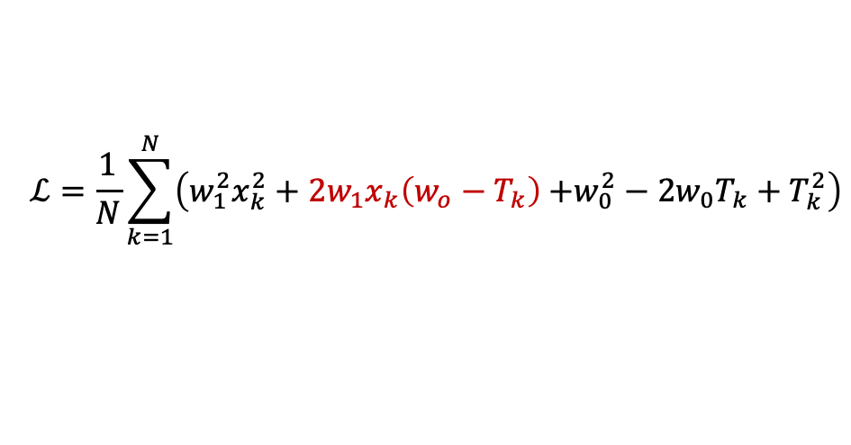
$$ℒ=\frac{1}{N}\sum_{k=1}^{N}{ℒ_{k}}\left(T_{k}, f\left(x_{k},w_{0}, w_{1}\right)\right)$$
$$f\left(x, w_{0}, w_{1}\right)=w_{0}+w_{1}x$$
$$ℒ=\frac{1}{N}\sum_{k=1}^{N}{{\left(T_{k}− f\left(x_{k},w_{0}, w_{1}\right)\right)}^{2}}$$
$$ℒ=\frac{1}{N}\sum_{k=1}^{N}{{\left(T_{k}− \left(w_{0}+w_{1}x_{k}\right)\right)}^{2}}$$
$$ℒ=\frac{1}{N}\sum_{k=1}^{N}{\left({T_{k}^{2}−2T_{k}\left(w_{0}+w_{1}x_{k}\right)+\left(w_{0}+w_{1}x_{k}\right)}^{2}\right)}$$
$$ℒ=\frac{1}{N}\sum_{k=1}^{N}{\left(T_{k}^{2}−2{w_{0}T}_{k}−2{w_{1}x_{k}T}_{k}+w_{0}^{2}+2{w_{o}w_{1}x}_{k}+w_{1}^{2}x_{k}^{2}\right)}$$
$$ℒ=\frac{1}{N}\sum_{k=1}^{N}{\left(w_{1}^{2}x_{k}^{2}+2{w_{1}x}_{k}\left(w_{o}−T_{k}\right){+w_{0}^{2}−2{w_{0}T}_{k}+T}_{k}^{2}\right)}$$

Slide 27
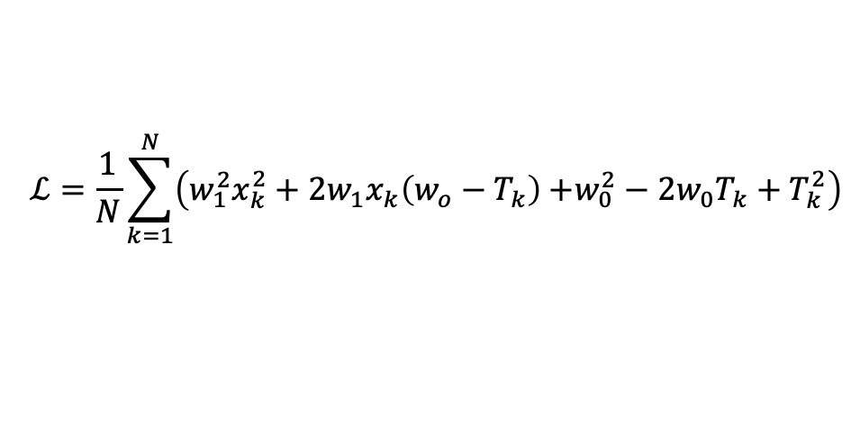
$$ℒ=\frac{1}{N}\sum_{k=1}^{N}{\left(w_{1}^{2}x_{k}^{2}+2{w_{1}x}_{k}\left(w_{o}−T_{k}\right){+w_{0}^{2}−2{w_{0}T}_{k}+T}_{k}^{2}\right)}$$

Slide 28
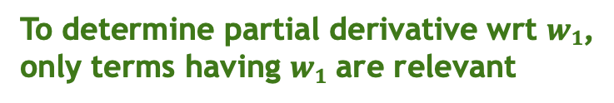
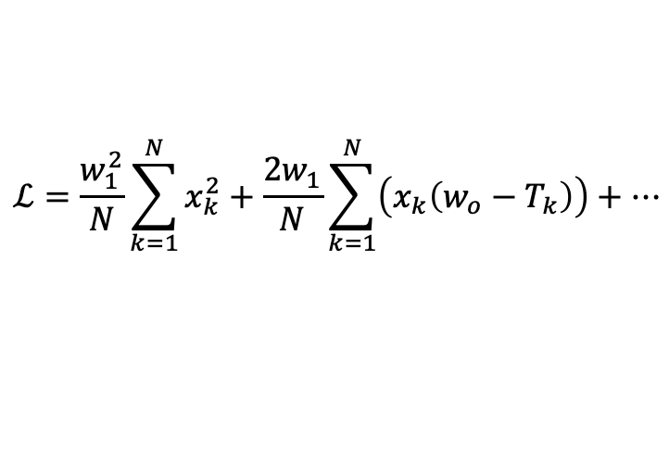
$$ℒ=\frac{1}{N}\sum_{k=1}^{N}{\left(w_{1}^{2}x_{k}^{2}+2{w_{1}x}_{k}\left(w_{o}−T_{k}\right){+w_{0}^{2}−2{w_{0}T}_{k}+T}_{k}^{2}\right)}$$
To determine partial derivative wrt $w1$,
only terms having $w1$ are relevant
$$ℒ=\frac{w_{1}^{2}}{N}\sum_{k=1}^{N}{x_{k}^{2}}+\frac{2w_{1}}{N}\sum_{k=1}^{N}{\left(x_{k}\left(w_{o}−T_{k}\right)\right)}+…$$

Slide 29

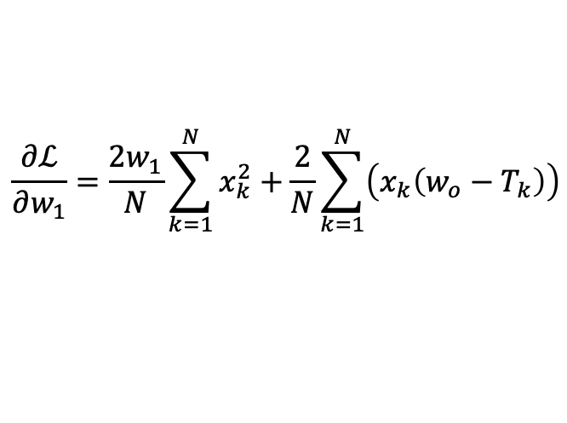
$$ℒ=\frac{1}{N}\sum_{k=1}^{N}{\left(w_{1}^{2}x_{k}^{2}+2{w_{1}x}_{k}\left(w_{o}−T_{k}\right){+w_{0}^{2}−2{w_{0}T}_{k}+T}_{k}^{2}\right)}$$
To determine partial derivative wrt $w1$,
only terms having $w1$ are relevant
$$ℒ=\frac{w_{1}^{2}}{N}\sum_{k=1}^{N}{x_{k}^{2}}+\frac{2w_{1}}{N}\sum_{k=1}^{N}{\left(x_{k}\left(w_{o}−T_{k}\right)\right)}+…$$
Partial derivative wrt $w1$
$$\frac{∂ℒ}{∂w_{1}}=\frac{2w_{1}}{N}\sum_{k=1}^{N}{x_{k}^{2}}+\frac{2}{N}\sum_{k=1}^{N}{\left(x_{k}\left(w_{o}−T_{k}\right)\right)}$$

Slide 30
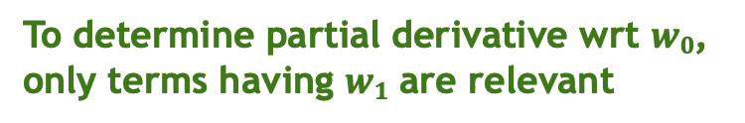
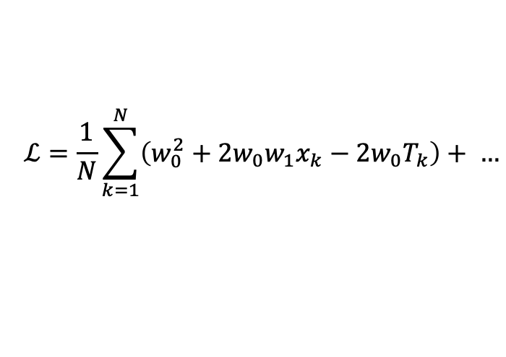
$$ℒ=\frac{1}{N}\sum_{k=1}^{N}{\left(w_{1}^{2}x_{k}^{2}+2{w_{1}x}_{k}\left(w_{o}−T_{k}\right){+w_{0}^{2}−2{w_{0}T}_{k}+T}_{k}^{2}\right)}$$
To determine partial derivative wrt $w0$,
only terms having $w1$ are relevant
To determine partial derivative wrt $w1$,
only terms having $w1$ are relevant
$$ℒ=\frac{1}{N}\sum_{k=1}^{N}{\left(w_{0}^{2}+2{w_{0}w_{1}x}_{k}−2{w_{0}T}_{k}\right)}+ …$$
$$ℒ=\frac{w_{1}^{2}}{N}\sum_{k=1}^{N}{x_{k}^{2}}+\frac{2w_{1}}{N}\sum_{k=1}^{N}{\left(x_{k}\left(w_{o}−T_{k}\right)\right)}+…$$
Partial derivative wrt $w1$
$$\frac{∂ℒ}{∂w_{1}}=\frac{2w_{1}}{N}\sum_{k=1}^{N}{x_{k}^{2}}+\frac{2}{N}\sum_{k=1}^{N}{\left(x_{k}\left(w_{o}−T_{k}\right)\right)}$$

Slide 31
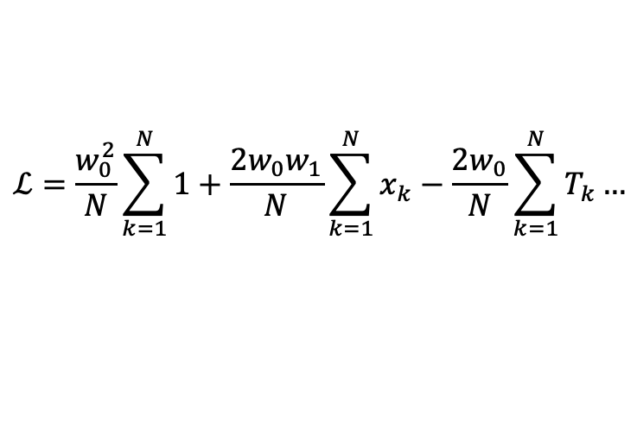
$$ℒ=\frac{1}{N}\sum_{k=1}^{N}{\left(w_{1}^{2}x_{k}^{2}+2{w_{1}x}_{k}\left(w_{o}−T_{k}\right){+w_{0}^{2}−2{w_{0}T}_{k}+T}_{k}^{2}\right)}$$
To determine partial derivative wrt $w0$,
only terms having $w1$ are relevant
To determine partial derivative wrt $w1$,
only terms having $w1$ are relevant
$$ℒ=\frac{1}{N}\sum_{k=1}^{N}{\left(w_{0}^{2}+2{w_{0}w_{1}x}_{k}−2{w_{0}T}_{k}\right)}+ …$$
$$ℒ=\frac{w_{1}^{2}}{N}\sum_{k=1}^{N}{x_{k}^{2}}+\frac{2w_{1}}{N}\sum_{k=1}^{N}{\left(x_{k}\left(w_{o}−T_{k}\right)\right)}+…$$
$$ℒ=\frac{w_{0}^{2}}{N}\sum_{k=1}^{N}{1}+\frac{2w_{0}w_{1}}{N}\sum_{k=1}^{N}{x_{k}}−\frac{2w_{0}}{N}\sum_{k=1}^{N}{T_{k}}…$$
Partial derivative wrt $w1$
$$\frac{∂ℒ}{∂w_{1}}=\frac{2w_{1}}{N}\sum_{k=1}^{N}{x_{k}^{2}}+\frac{2}{N}\sum_{k=1}^{N}{\left(x_{k}\left(w_{o}−T_{k}\right)\right)}$$

Slide 32
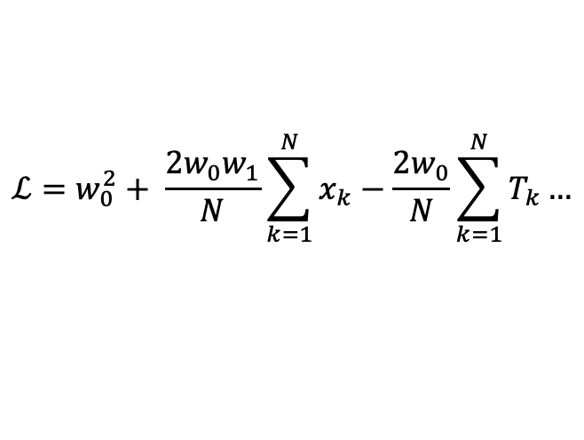
$$ℒ=\frac{1}{N}\sum_{k=1}^{N}{\left(w_{1}^{2}x_{k}^{2}+2{w_{1}x}_{k}\left(w_{o}−T_{k}\right){+w_{0}^{2}−2{w_{0}T}_{k}+T}_{k}^{2}\right)}$$
To determine partial derivative wrt $w0$,
only terms having $w1$ are relevant
To determine partial derivative wrt $w1$,
only terms having $w1$ are relevant
$$ℒ=\frac{1}{N}\sum_{k=1}^{N}{\left(w_{0}^{2}+2{w_{0}w_{1}x}_{k}−2{w_{0}T}_{k}\right)}+ …$$
$$ℒ=\frac{w_{1}^{2}}{N}\sum_{k=1}^{N}{x_{k}^{2}}+\frac{2w_{1}}{N}\sum_{k=1}^{N}{\left(x_{k}\left(w_{o}−T_{k}\right)\right)}+…$$
$$ℒ=\frac{w_{0}^{2}}{N}\sum_{k=1}^{N}{1}+\frac{2w_{0}w_{1}}{N}\sum_{k=1}^{N}{x_{k}}−\frac{2w_{0}}{N}\sum_{k=1}^{N}{T_{k}}…$$
$$ℒ=w_{0}^{2}+ \frac{2w_{0}w_{1}}{N}\sum_{k=1}^{N}{x_{k}}−\frac{2w_{0}}{N}\sum_{k=1}^{N}{T_{k}}…$$
Partial derivative wrt $w1$
$$\frac{∂ℒ}{∂w_{1}}=\frac{2w_{1}}{N}\sum_{k=1}^{N}{x_{k}^{2}}+\frac{2}{N}\sum_{k=1}^{N}{\left(x_{k}\left(w_{o}−T_{k}\right)\right)}$$

Slide 33
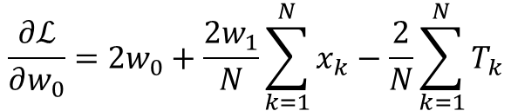

$$ℒ=\frac{1}{N}\sum_{k=1}^{N}{\left(w_{1}^{2}x_{k}^{2}+2{w_{1}x}_{k}\left(w_{o}−T_{k}\right){+w_{0}^{2}−2{w_{0}T}_{k}+T}_{k}^{2}\right)}$$
To determine partial derivative wrt $w0$,
only terms having $w1$ are relevant
To determine partial derivative wrt $w1$,
only terms having $w1$ are relevant
$$ℒ=\frac{1}{N}\sum_{k=1}^{N}{\left(w_{0}^{2}+2{w_{0}w_{1}x}_{k}−2{w_{0}T}_{k}\right)}+ …$$
$$ℒ=\frac{w_{1}^{2}}{N}\sum_{k=1}^{N}{x_{k}^{2}}+\frac{2w_{1}}{N}\sum_{k=1}^{N}{\left(x_{k}\left(w_{o}−T_{k}\right)\right)}+…$$
$$ℒ=\frac{w_{0}^{2}}{N}\sum_{k=1}^{N}{1}+\frac{2w_{0}w_{1}}{N}\sum_{k=1}^{N}{x_{k}}−\frac{2w_{0}}{N}\sum_{k=1}^{N}{T_{k}}…$$
$$ℒ=w_{0}^{2}+ \frac{2w_{0}w_{1}}{N}\sum_{k=1}^{N}{x_{k}}−\frac{2w_{0}}{N}\sum_{k=1}^{N}{T_{k}}…$$
Partial derivative wrt $w1$
Partial derivative wrt $w1$
$$\frac{∂ℒ}{∂w_{1}}=\frac{2w_{1}}{N}\sum_{k=1}^{N}{x_{k}^{2}}+\frac{2}{N}\sum_{k=1}^{N}{\left(x_{k}\left(w_{o}−T_{k}\right)\right)}$$
$$\frac{∂ℒ}{∂w_{0}}=2w_{0}+\frac{2w_{1}}{N}\sum_{k=1}^{N}{x_{k}}−\frac{2}{N}\sum_{k=1}^{N}{T_{k}}$$

Slide 34
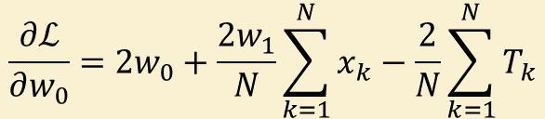
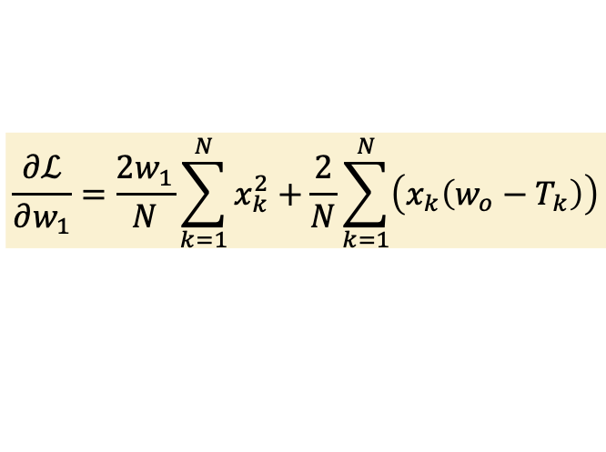
$$ℒ=\frac{1}{N}\sum_{k=1}^{N}{\left(w_{1}^{2}x_{k}^{2}+2{w_{1}x}_{k}\left(w_{o}−T_{k}\right){+w_{0}^{2}−2{w_{0}T}_{k}+T}_{k}^{2}\right)}$$
To determine partial derivative wrt $w0$,
only terms having $w1$ are relevant
To determine partial derivative wrt $w1$,
only terms having $w1$ are relevant
$$ℒ=\frac{1}{N}\sum_{k=1}^{N}{\left(w_{0}^{2}+2{w_{0}w_{1}x}_{k}−2{w_{0}T}_{k}\right)}+ …$$
$$ℒ=\frac{w_{1}^{2}}{N}\sum_{k=1}^{N}{x_{k}^{2}}+\frac{2w_{1}}{N}\sum_{k=1}^{N}{\left(x_{k}\left(w_{o}−T_{k}\right)\right)}+…$$
$$ℒ=\frac{w_{0}^{2}}{N}\sum_{k=1}^{N}{1}+\frac{2w_{0}w_{1}}{N}\sum_{k=1}^{N}{x_{k}}−\frac{2w_{0}}{N}\sum_{k=1}^{N}{T_{k}}…$$
$$ℒ=w_{0}^{2}+ \frac{2w_{0}w_{1}}{N}\sum_{k=1}^{N}{x_{k}}−\frac{2w_{0}}{N}\sum_{k=1}^{N}{T_{k}}…$$
Partial derivative wrt $w1$
Partial derivative wrt $w1$
$$\frac{∂ℒ}{∂w_{1}}=\frac{2w_{1}}{N}\sum_{k=1}^{N}{x_{k}^{2}}+\frac{2}{N}\sum_{k=1}^{N}{\left(x_{k}\left(w_{o}−T_{k}\right)\right)}$$
$$\frac{∂ℒ}{∂w_{0}}=2w_{0}+\frac{2w_{1}}{N}\sum_{k=1}^{N}{x_{k}}−\frac{2}{N}\sum_{k=1}^{N}{T_{k}}$$
For optimal solution for $w_{1}$ and $w_{1}$ we need to solve $\frac{∂𝓛}{∂w_{1}}=0$ and $\frac{∂𝓛}{∂w_{2}}=0$

Slide 35
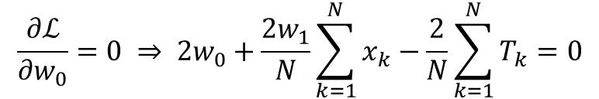
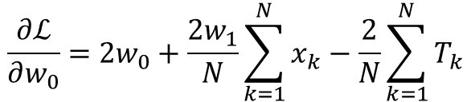
$$\frac{∂ℒ}{∂w_{0}}=2w_{0}+\frac{2w_{1}}{N}\sum_{k=1}^{N}{x_{k}}−\frac{2}{N}\sum_{k=1}^{N}{T_{k}}$$
$$\frac{∂ℒ}{∂w_{0}}=0 ⇒ 2w_{0}+\frac{2w_{1}}{N}\sum_{k=1}^{N}{x_{k}}−\frac{2}{N}\sum_{k=1}^{N}{T_{k}}=0$$

Slide 36
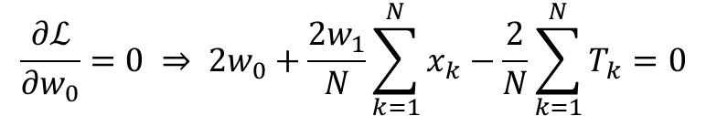
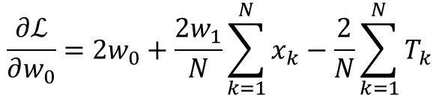
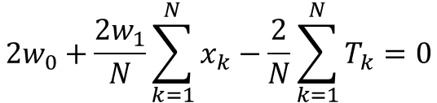
$$\frac{∂ℒ}{∂w_{0}}=2w_{0}+\frac{2w_{1}}{N}\sum_{k=1}^{N}{x_{k}}−\frac{2}{N}\sum_{k=1}^{N}{T_{k}}$$
$$\frac{∂ℒ}{∂w_{0}}=0 ⇒ 2w_{0}+\frac{2w_{1}}{N}\sum_{k=1}^{N}{x_{k}}−\frac{2}{N}\sum_{k=1}^{N}{T_{k}}=0$$
$$2w_{0}+\frac{2w_{1}}{N}\sum_{k=1}^{N}{x_{k}}−\frac{2}{N}\sum_{k=1}^{N}{T_{k}}=0$$

Slide 37
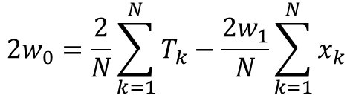
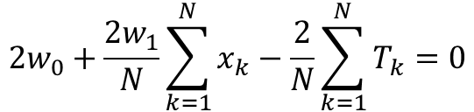
$$\frac{∂ℒ}{∂w_{0}}=2w_{0}+\frac{2w_{1}}{N}\sum_{k=1}^{N}{x_{k}}−\frac{2}{N}\sum_{k=1}^{N}{T_{k}}$$
$$\frac{∂ℒ}{∂w_{0}}=0 ⇒ 2w_{0}+\frac{2w_{1}}{N}\sum_{k=1}^{N}{x_{k}}−\frac{2}{N}\sum_{k=1}^{N}{T_{k}}=0$$
$$2w_{0}+\frac{2w_{1}}{N}\sum_{k=1}^{N}{x_{k}}−\frac{2}{N}\sum_{k=1}^{N}{T_{k}}=0$$
$$2w_{0}=\frac{2}{N}\sum_{k=1}^{N}{T_{k}}−\frac{2w_{1}}{N}\sum_{k=1}^{N}{x_{k}}$$

Slide 38
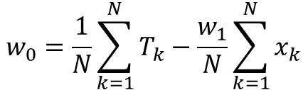
$$\frac{∂ℒ}{∂w_{0}}=2w_{0}+\frac{2w_{1}}{N}\sum_{k=1}^{N}{x_{k}}−\frac{2}{N}\sum_{k=1}^{N}{T_{k}}$$
$$\frac{∂ℒ}{∂w_{0}}=0 ⇒ 2w_{0}+\frac{2w_{1}}{N}\sum_{k=1}^{N}{x_{k}}−\frac{2}{N}\sum_{k=1}^{N}{T_{k}}=0$$
$$2w_{0}+\frac{2w_{1}}{N}\sum_{k=1}^{N}{x_{k}}−\frac{2}{N}\sum_{k=1}^{N}{T_{k}}=0$$
$$2w_{0}=\frac{2}{N}\sum_{k=1}^{N}{T_{k}}−\frac{2w_{1}}{N}\sum_{k=1}^{N}{x_{k}}$$
$$w_{0}=\frac{1}{N}\sum_{k=1}^{N}{T_{k}}−\frac{w_{1}}{N}\sum_{k=1}^{N}{x_{k}}$$

Slide 39

$$\frac{∂ℒ}{∂w_{0}}=2w_{0}+\frac{2w_{1}}{N}\sum_{k=1}^{N}{x_{k}}−\frac{2}{N}\sum_{k=1}^{N}{T_{k}}$$
$$\frac{∂ℒ}{∂w_{0}}=0 ⇒ 2w_{0}+\frac{2w_{1}}{N}\sum_{k=1}^{N}{x_{k}}−\frac{2}{N}\sum_{k=1}^{N}{T_{k}}=0$$
$$2w_{0}+\frac{2w_{1}}{N}\sum_{k=1}^{N}{x_{k}}−\frac{2}{N}\sum_{k=1}^{N}{T_{k}}=0$$
$$2w_{0}=\frac{2}{N}\sum_{k=1}^{N}{T_{k}}−\frac{2w_{1}}{N}\sum_{k=1}^{N}{x_{k}}$$
$$w_{0}=\frac{1}{N}\sum_{k=1}^{N}{T_{k}}−\frac{w_{1}}{N}\sum_{k=1}^{N}{x_{k}}$$
$$w_{0}=\overline{T} −w_{1}\overline{x}$$

Slide 40

$$\frac{∂ℒ}{∂w_{0}}=2w_{0}+\frac{2w_{1}}{N}\sum_{k=1}^{N}{x_{k}}−\frac{2}{N}\sum_{k=1}^{N}{T_{k}}$$
$$\frac{∂ℒ}{∂w_{0}}=0 ⇒ 2w_{0}+\frac{2w_{1}}{N}\sum_{k=1}^{N}{x_{k}}−\frac{2}{N}\sum_{k=1}^{N}{T_{k}}=0$$
$$2w_{0}+\frac{2w_{1}}{N}\sum_{k=1}^{N}{x_{k}}−\frac{2}{N}\sum_{k=1}^{N}{T_{k}}=0$$
$$2w_{0}=\frac{2}{N}\sum_{k=1}^{N}{T_{k}}−\frac{2w_{1}}{N}\sum_{k=1}^{N}{x_{k}}$$
$$w_{0}=\frac{1}{N}\sum_{k=1}^{N}{T_{k}}−\frac{w_{1}}{N}\sum_{k=1}^{N}{x_{k}}$$
$$w_{0}=\overline{T} −w_{1}\overline{x}$$
$$\hat{w_{o}}=\overline{t} − w_{1}\overline{x}$$

Slide 41
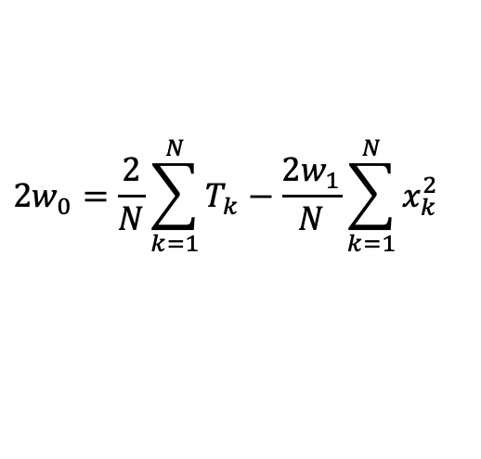
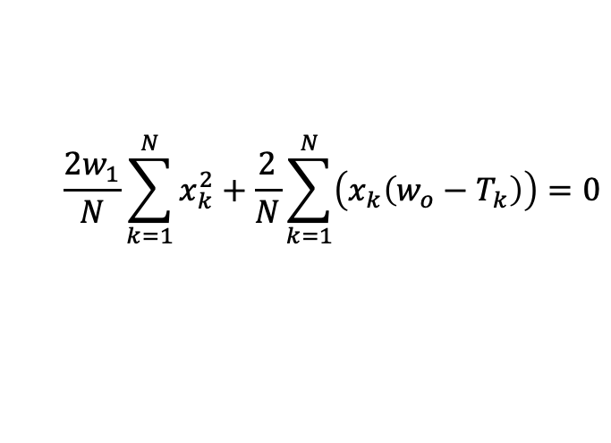
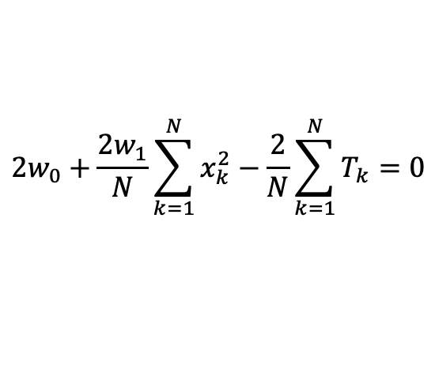
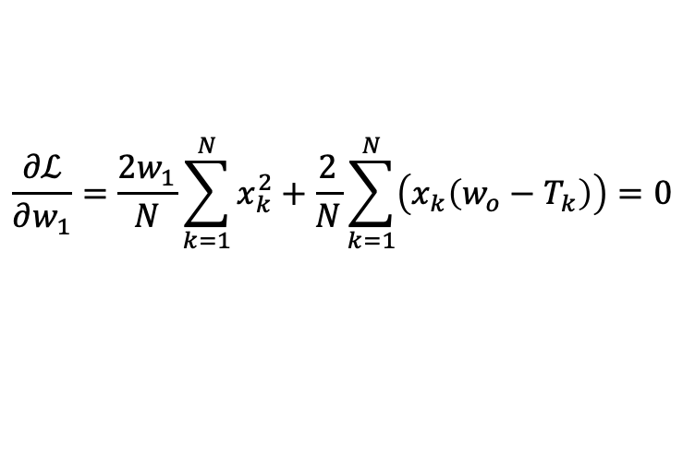
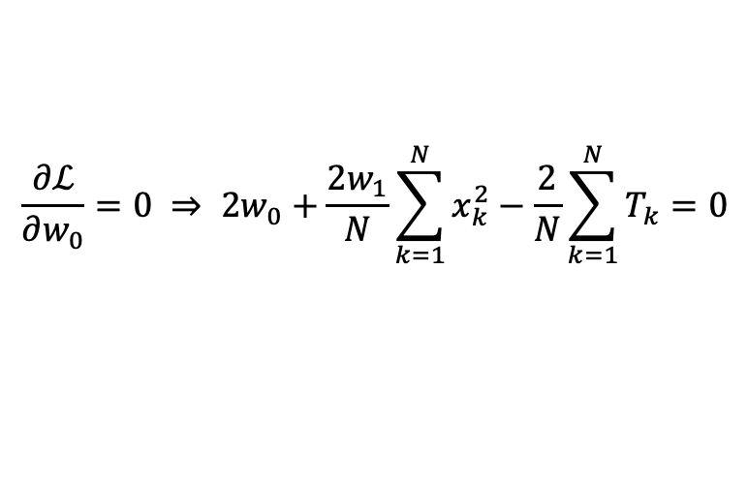
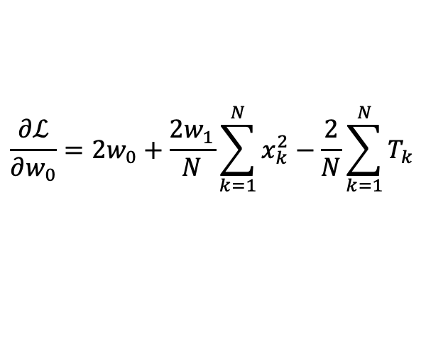
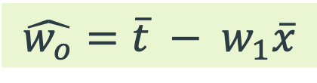

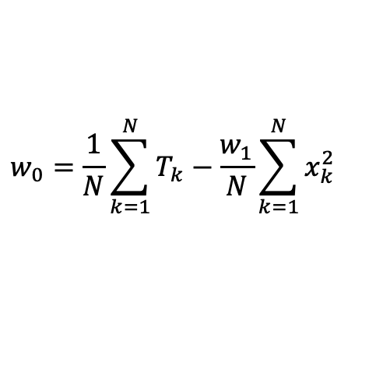
$$\frac{∂ℒ}{∂w_{1}}=\frac{2w_{1}}{N}\sum_{k=1}^{N}{x_{k}^{2}}+\frac{2}{N}\sum_{k=1}^{N}{\left(x_{k}\left(w_{o}−T_{k}\right)\right)}=0$$
$$\frac{∂ℒ}{∂w_{0}}=2w_{0}+\frac{2w_{1}}{N}\sum_{k=1}^{N}{x_{k}^{2}}−\frac{2}{N}\sum_{k=1}^{N}{T_{k}}$$
$$\frac{2w_{1}}{N}\sum_{k=1}^{N}{x_{k}^{2}}+\frac{2}{N}\sum_{k=1}^{N}{\left(x_{k}\left(w_{o}−T_{k}\right)\right)=0}$$
$$\frac{∂ℒ}{∂w_{0}}=0 ⇒ 2w_{0}+\frac{2w_{1}}{N}\sum_{k=1}^{N}{x_{k}^{2}}−\frac{2}{N}\sum_{k=1}^{N}{T_{k}}=0$$
$$2w_{0}+\frac{2w_{1}}{N}\sum_{k=1}^{N}{x_{k}^{2}}−\frac{2}{N}\sum_{k=1}^{N}{T_{k}}=0$$
$$2w_{0}=\frac{2}{N}\sum_{k=1}^{N}{T_{k}}−\frac{2w_{1}}{N}\sum_{k=1}^{N}{x_{k}^{2}}$$
$$w_{0}=\frac{1}{N}\sum_{k=1}^{N}{T_{k}}−\frac{w_{1}}{N}\sum_{k=1}^{N}{x_{k}^{2}}$$
$$w_{0}=\overline{T} −w_{1}\overline{x}$$
$$\hat{w_{o}}=\overline{t} − w_{1}\overline{x}$$

Slide 42
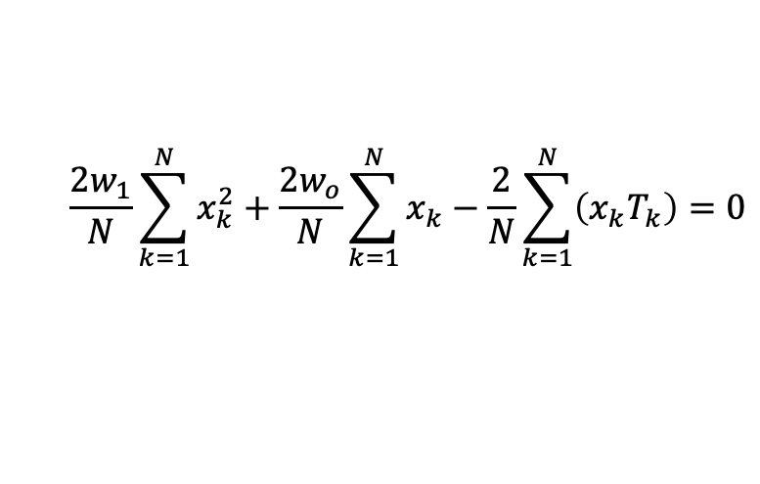
$$\frac{∂ℒ}{∂w_{1}}=\frac{2w_{1}}{N}\sum_{k=1}^{N}{x_{k}^{2}}+\frac{2}{N}\sum_{k=1}^{N}{\left(x_{k}\left(w_{o}−T_{k}\right)\right)}=0$$
$$\frac{∂ℒ}{∂w_{0}}=2w_{0}+\frac{2w_{1}}{N}\sum_{k=1}^{N}{x_{k}^{2}}−\frac{2}{N}\sum_{k=1}^{N}{T_{k}}$$
$$\frac{2w_{1}}{N}\sum_{k=1}^{N}{x_{k}^{2}}+\frac{2}{N}\sum_{k=1}^{N}{\left(x_{k}\left(w_{o}−T_{k}\right)\right)=0}$$
$$\frac{∂ℒ}{∂w_{0}}=0 ⇒ 2w_{0}+\frac{2w_{1}}{N}\sum_{k=1}^{N}{x_{k}^{2}}−\frac{2}{N}\sum_{k=1}^{N}{T_{k}}=0$$
$$\frac{2w_{1}}{N}\sum_{k=1}^{N}{x_{k}^{2}}+\frac{2w_{o}}{N}\sum_{k=1}^{N}{x_{k}−\frac{2}{N}\sum_{k=1}^{N}{\left(x_{k}T_{k}\right)}=0}$$
$$2w_{0}+\frac{2w_{1}}{N}\sum_{k=1}^{N}{x_{k}^{2}}−\frac{2}{N}\sum_{k=1}^{N}{T_{k}}=0$$
$$2w_{0}=\frac{2}{N}\sum_{k=1}^{N}{T_{k}}−\frac{2w_{1}}{N}\sum_{k=1}^{N}{x_{k}^{2}}$$
$$w_{0}=\frac{1}{N}\sum_{k=1}^{N}{T_{k}}−\frac{w_{1}}{N}\sum_{k=1}^{N}{x_{k}^{2}}$$
$$w_{0}=\overline{T} −w_{1}\overline{x}$$
$$\hat{w_{o}}=\overline{t} − w_{1}\overline{x}$$

Slide 43
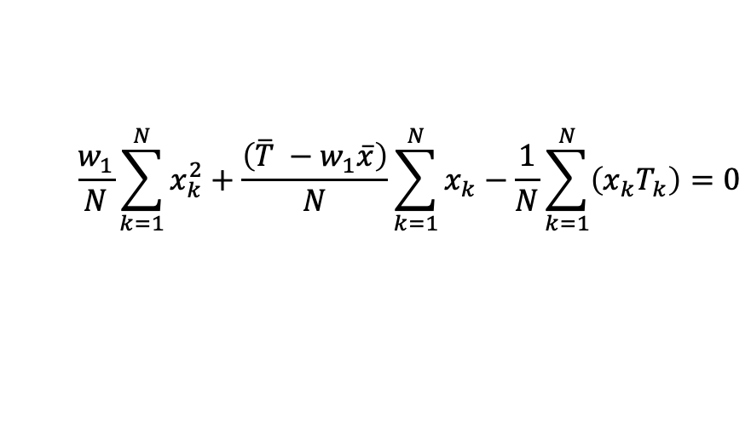
$$\frac{∂ℒ}{∂w_{1}}=\frac{2w_{1}}{N}\sum_{k=1}^{N}{x_{k}^{2}}+\frac{2}{N}\sum_{k=1}^{N}{\left(x_{k}\left(w_{o}−T_{k}\right)\right)}=0$$
$$\frac{∂ℒ}{∂w_{0}}=2w_{0}+\frac{2w_{1}}{N}\sum_{k=1}^{N}{x_{k}^{2}}−\frac{2}{N}\sum_{k=1}^{N}{T_{k}}$$
$$\frac{2w_{1}}{N}\sum_{k=1}^{N}{x_{k}^{2}}+\frac{2}{N}\sum_{k=1}^{N}{\left(x_{k}\left(w_{o}−T_{k}\right)\right)=0}$$
$$\frac{∂ℒ}{∂w_{0}}=0 ⇒ 2w_{0}+\frac{2w_{1}}{N}\sum_{k=1}^{N}{x_{k}^{2}}−\frac{2}{N}\sum_{k=1}^{N}{T_{k}}=0$$
$$\frac{2w_{1}}{N}\sum_{k=1}^{N}{x_{k}^{2}}+\frac{2w_{o}}{N}\sum_{k=1}^{N}{x_{k}−\frac{2}{N}\sum_{k=1}^{N}{\left(x_{k}T_{k}\right)}=0}$$
$$2w_{0}+\frac{2w_{1}}{N}\sum_{k=1}^{N}{x_{k}^{2}}−\frac{2}{N}\sum_{k=1}^{N}{T_{k}}=0$$
$$\frac{w_{1}}{N}\sum_{k=1}^{N}{x_{k}^{2}}+\frac{\left(\overline{T} −w_{1}\overline{x}\right)}{N}\sum_{k=1}^{N}{x_{k}−\frac{1}{N}\sum_{k=1}^{N}{\left(x_{k}T_{k}\right)}=0}$$
$$2w_{0}=\frac{2}{N}\sum_{k=1}^{N}{T_{k}}−\frac{2w_{1}}{N}\sum_{k=1}^{N}{x_{k}^{2}}$$
$$w_{0}=\frac{1}{N}\sum_{k=1}^{N}{T_{k}}−\frac{w_{1}}{N}\sum_{k=1}^{N}{x_{k}^{2}}$$
$$w_{0}=\overline{T} −w_{1}\overline{x}$$
$$\hat{w_{o}}=\overline{t} − w_{1}\overline{x}$$

Slide 44
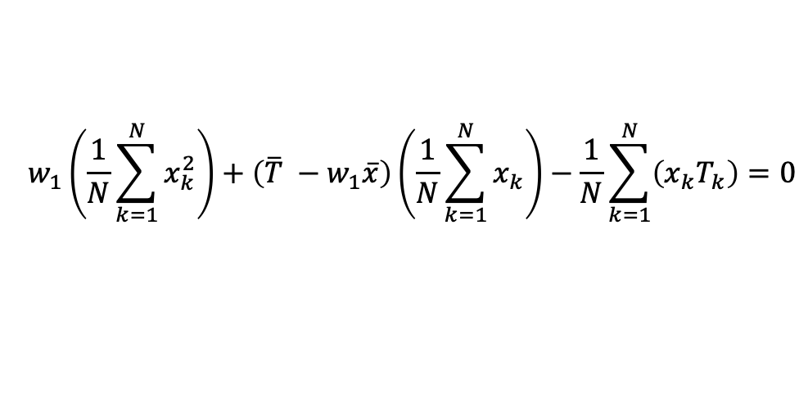
$$\frac{∂ℒ}{∂w_{1}}=\frac{2w_{1}}{N}\sum_{k=1}^{N}{x_{k}^{2}}+\frac{2}{N}\sum_{k=1}^{N}{\left(x_{k}\left(w_{o}−T_{k}\right)\right)}=0$$
$$\frac{∂ℒ}{∂w_{0}}=2w_{0}+\frac{2w_{1}}{N}\sum_{k=1}^{N}{x_{k}^{2}}−\frac{2}{N}\sum_{k=1}^{N}{T_{k}}$$
$$\frac{2w_{1}}{N}\sum_{k=1}^{N}{x_{k}^{2}}+\frac{2}{N}\sum_{k=1}^{N}{\left(x_{k}\left(w_{o}−T_{k}\right)\right)=0}$$
$$\frac{∂ℒ}{∂w_{0}}=0 ⇒ 2w_{0}+\frac{2w_{1}}{N}\sum_{k=1}^{N}{x_{k}^{2}}−\frac{2}{N}\sum_{k=1}^{N}{T_{k}}=0$$
$$\frac{2w_{1}}{N}\sum_{k=1}^{N}{x_{k}^{2}}+\frac{2w_{o}}{N}\sum_{k=1}^{N}{x_{k}−\frac{2}{N}\sum_{k=1}^{N}{\left(x_{k}T_{k}\right)}=0}$$
$$2w_{0}+\frac{2w_{1}}{N}\sum_{k=1}^{N}{x_{k}^{2}}−\frac{2}{N}\sum_{k=1}^{N}{T_{k}}=0$$
$$\frac{w_{1}}{N}\sum_{k=1}^{N}{x_{k}^{2}}+\frac{\left(\overline{T} −w_{1}\overline{x}\right)}{N}\sum_{k=1}^{N}{x_{k}−\frac{1}{N}\sum_{k=1}^{N}{\left(x_{k}T_{k}\right)}=0}$$
$$2w_{0}=\frac{2}{N}\sum_{k=1}^{N}{T_{k}}−\frac{2w_{1}}{N}\sum_{k=1}^{N}{x_{k}^{2}}$$
$$w_{1}\left(\frac{1}{N}\sum_{k=1}^{N}{x_{k}^{2}}\right)+\left(\overline{T} −w_{1}\overline{x}\right)\left(\frac{1}{N}\sum_{k=1}^{N}{x_{k}}\right)−\frac{1}{N}\sum_{k=1}^{N}{\left(x_{k}T_{k}\right)}=0$$
$$w_{0}=\frac{1}{N}\sum_{k=1}^{N}{T_{k}}−\frac{w_{1}}{N}\sum_{k=1}^{N}{x_{k}^{2}}$$
$$w_{0}=\overline{T} −w_{1}\overline{x}$$
$$\hat{w_{o}}=\overline{t} − w_{1}\overline{x}$$

Slide 45
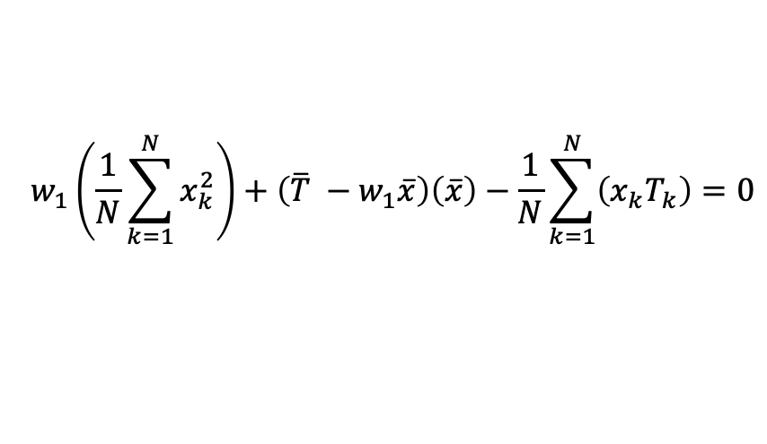
$$\frac{∂ℒ}{∂w_{1}}=\frac{2w_{1}}{N}\sum_{k=1}^{N}{x_{k}^{2}}+\frac{2}{N}\sum_{k=1}^{N}{\left(x_{k}\left(w_{o}−T_{k}\right)\right)}=0$$
$$\frac{∂ℒ}{∂w_{0}}=2w_{0}+\frac{2w_{1}}{N}\sum_{k=1}^{N}{x_{k}^{2}}−\frac{2}{N}\sum_{k=1}^{N}{T_{k}}$$
$$\frac{2w_{1}}{N}\sum_{k=1}^{N}{x_{k}^{2}}+\frac{2}{N}\sum_{k=1}^{N}{\left(x_{k}\left(w_{o}−T_{k}\right)\right)=0}$$
$$\frac{∂ℒ}{∂w_{0}}=0 ⇒ 2w_{0}+\frac{2w_{1}}{N}\sum_{k=1}^{N}{x_{k}^{2}}−\frac{2}{N}\sum_{k=1}^{N}{T_{k}}=0$$
$$\frac{2w_{1}}{N}\sum_{k=1}^{N}{x_{k}^{2}}+\frac{2w_{o}}{N}\sum_{k=1}^{N}{x_{k}−\frac{2}{N}\sum_{k=1}^{N}{\left(x_{k}T_{k}\right)}=0}$$
$$2w_{0}+\frac{2w_{1}}{N}\sum_{k=1}^{N}{x_{k}^{2}}−\frac{2}{N}\sum_{k=1}^{N}{T_{k}}=0$$
$$\frac{w_{1}}{N}\sum_{k=1}^{N}{x_{k}^{2}}+\frac{\left(\overline{T} −w_{1}\overline{x}\right)}{N}\sum_{k=1}^{N}{x_{k}−\frac{1}{N}\sum_{k=1}^{N}{\left(x_{k}T_{k}\right)}=0}$$
$$2w_{0}=\frac{2}{N}\sum_{k=1}^{N}{T_{k}}−\frac{2w_{1}}{N}\sum_{k=1}^{N}{x_{k}^{2}}$$
$$w_{1}\left(\frac{1}{N}\sum_{k=1}^{N}{x_{k}^{2}}\right)+\left(\overline{T} −w_{1}\overline{x}\right)\left(\frac{1}{N}\sum_{k=1}^{N}{x_{k}}\right)−\frac{1}{N}\sum_{k=1}^{N}{\left(x_{k}T_{k}\right)}=0$$
$$w_{0}=\frac{1}{N}\sum_{k=1}^{N}{T_{k}}−\frac{w_{1}}{N}\sum_{k=1}^{N}{x_{k}^{2}}$$
$$w_{1}\left(\frac{1}{N}\sum_{k=1}^{N}{x_{k}^{2}}\right)+\left(\overline{T} −w_{1}\overline{x}\right)\left(\overline{x}\right)−\frac{1}{N}\sum_{k=1}^{N}{\left(x_{k}T_{k}\right)}=0$$
$$w_{0}=\overline{T} −w_{1}\overline{x}$$
$$\hat{w_{o}}=\overline{t} − w_{1}\overline{x}$$

Slide 46

$$\frac{∂ℒ}{∂w_{1}}=\frac{2w_{1}}{N}\sum_{k=1}^{N}{x_{k}^{2}}+\frac{2}{N}\sum_{k=1}^{N}{\left(x_{k}\left(w_{o}−T_{k}\right)\right)}=0$$
$$\frac{∂ℒ}{∂w_{0}}=2w_{0}+\frac{2w_{1}}{N}\sum_{k=1}^{N}{x_{k}^{2}}−\frac{2}{N}\sum_{k=1}^{N}{T_{k}}$$
$$\frac{2w_{1}}{N}\sum_{k=1}^{N}{x_{k}^{2}}+\frac{2}{N}\sum_{k=1}^{N}{\left(x_{k}\left(w_{o}−T_{k}\right)\right)=0}$$
$$\frac{∂ℒ}{∂w_{0}}=0 ⇒ 2w_{0}+\frac{2w_{1}}{N}\sum_{k=1}^{N}{x_{k}^{2}}−\frac{2}{N}\sum_{k=1}^{N}{T_{k}}=0$$
$$\frac{2w_{1}}{N}\sum_{k=1}^{N}{x_{k}^{2}}+\frac{2w_{o}}{N}\sum_{k=1}^{N}{x_{k}−\frac{2}{N}\sum_{k=1}^{N}{\left(x_{k}T_{k}\right)}=0}$$
$$2w_{0}+\frac{2w_{1}}{N}\sum_{k=1}^{N}{x_{k}^{2}}−\frac{2}{N}\sum_{k=1}^{N}{T_{k}}=0$$
$$\frac{w_{1}}{N}\sum_{k=1}^{N}{x_{k}^{2}}+\frac{\left(\overline{T} −w_{1}\overline{x}\right)}{N}\sum_{k=1}^{N}{x_{k}−\frac{1}{N}\sum_{k=1}^{N}{\left(x_{k}T_{k}\right)}=0}$$
$$2w_{0}=\frac{2}{N}\sum_{k=1}^{N}{T_{k}}−\frac{2w_{1}}{N}\sum_{k=1}^{N}{x_{k}^{2}}$$
$$w_{1}\left(\frac{1}{N}\sum_{k=1}^{N}{x_{k}^{2}}\right)+\left(\overline{T} −w_{1}\overline{x}\right)\left(\frac{1}{N}\sum_{k=1}^{N}{x_{k}}\right)−\frac{1}{N}\sum_{k=1}^{N}{\left(x_{k}T_{k}\right)}=0$$
$$w_{0}=\frac{1}{N}\sum_{k=1}^{N}{T_{k}}−\frac{w_{1}}{N}\sum_{k=1}^{N}{x_{k}^{2}}$$
$$w_{1}\left(\frac{1}{N}\sum_{k=1}^{N}{x_{k}^{2}}\right)+\left(\overline{T} −w_{1}\overline{x}\right)\left(\overline{x}\right)−\frac{1}{N}\sum_{k=1}^{N}{\left(x_{k}T_{k}\right)}=0$$
$$w_{0}=\overline{T} −w_{1}\overline{x}$$
$$w_{1}=\frac{\frac{1}{N}\sum_{k=1}^{N}{\left(x_{k}T_{k}\right)}−\overline{T}.\overline{x}}{\left(\frac{1}{N}\sum_{k=1}^{N}{x_{k}^{2}}\right)−\overline{x}.\overline{x}}$$
$$\hat{w_{o}}=\overline{t} − w_{1}\overline{x}$$

Slide 47

$$\frac{∂ℒ}{∂w_{1}}=\frac{2w_{1}}{N}\sum_{k=1}^{N}{x_{k}^{2}}+\frac{2}{N}\sum_{k=1}^{N}{\left(x_{k}\left(w_{o}−T_{k}\right)\right)}=0$$
$$\frac{∂ℒ}{∂w_{0}}=2w_{0}+\frac{2w_{1}}{N}\sum_{k=1}^{N}{x_{k}^{2}}−\frac{2}{N}\sum_{k=1}^{N}{T_{k}}$$
$$\frac{2w_{1}}{N}\sum_{k=1}^{N}{x_{k}^{2}}+\frac{2}{N}\sum_{k=1}^{N}{\left(x_{k}\left(w_{o}−T_{k}\right)\right)=0}$$
$$\frac{∂ℒ}{∂w_{0}}=0 ⇒ 2w_{0}+\frac{2w_{1}}{N}\sum_{k=1}^{N}{x_{k}^{2}}−\frac{2}{N}\sum_{k=1}^{N}{T_{k}}=0$$
$$\frac{2w_{1}}{N}\sum_{k=1}^{N}{x_{k}^{2}}+\frac{2w_{o}}{N}\sum_{k=1}^{N}{x_{k}−\frac{2}{N}\sum_{k=1}^{N}{\left(x_{k}T_{k}\right)}=0}$$
$$2w_{0}+\frac{2w_{1}}{N}\sum_{k=1}^{N}{x_{k}^{2}}−\frac{2}{N}\sum_{k=1}^{N}{T_{k}}=0$$
$$\frac{w_{1}}{N}\sum_{k=1}^{N}{x_{k}^{2}}+\frac{\left(\overline{T} −w_{1}\overline{x}\right)}{N}\sum_{k=1}^{N}{x_{k}−\frac{1}{N}\sum_{k=1}^{N}{\left(x_{k}T_{k}\right)}=0}$$
$$2w_{0}=\frac{2}{N}\sum_{k=1}^{N}{T_{k}}−\frac{2w_{1}}{N}\sum_{k=1}^{N}{x_{k}^{2}}$$
$$w_{1}\left(\frac{1}{N}\sum_{k=1}^{N}{x_{k}^{2}}\right)+\left(\overline{T} −w_{1}\overline{x}\right)\left(\frac{1}{N}\sum_{k=1}^{N}{x_{k}}\right)−\frac{1}{N}\sum_{k=1}^{N}{\left(x_{k}T_{k}\right)}=0$$
$$w_{0}=\frac{1}{N}\sum_{k=1}^{N}{T_{k}}−\frac{w_{1}}{N}\sum_{k=1}^{N}{x_{k}^{2}}$$
$$w_{1}\left(\frac{1}{N}\sum_{k=1}^{N}{x_{k}^{2}}\right)+\left(\overline{T} −w_{1}\overline{x}\right)\left(\overline{x}\right)−\frac{1}{N}\sum_{k=1}^{N}{\left(x_{k}T_{k}\right)}=0$$
$$w_{0}=\overline{T} −w_{1}\overline{x}$$
$$\hat{w_{1}}=\frac{\overline{xt}−\overline{x}\overline{t}}{\overline{x^{2}}−{\left(\overline{x}\right)}^{2}}$$
$$w_{1}=\frac{\frac{1}{N}\sum_{k=1}^{N}{\left(x_{k}T_{k}\right)}−\overline{T}.\overline{x}}{\left(\frac{1}{N}\sum_{k=1}^{N}{x_{k}^{2}}\right)−\overline{x}.\overline{x}}$$
$$\hat{w_{o}}=\overline{t} − w_{1}\overline{x}$$

Slide 48



Example
$$\hat{w_{o}}=\overline{t} − w_{1}\overline{x}$$
$$\hat{w_{1}}=\frac{\overline{xt}−\overline{x}\overline{t}}{\overline{x^{2}}−{\left(\overline{x}\right)}^{2}}$$

Slide 49


Example
$$\hat{w_{1}}=\frac{\overline{xt}−\overline{x}\overline{t}}{\overline{x^{2}}−{\left(\overline{x}\right)}^{2}}$$

Slide 50



Example
$$\hat{w_{o}}=\overline{t} − w_{1}\overline{x}$$

Slide 51

Assignment

Slide 52

Assignment

Slide 53


Assignments

Slide 54
Linear Regression
Training for Linear Regression:
SSE (Sum of Squared Error): Least squares algorithm: Aims to minimize the sum of squared errors (error is difference between target and actual output) iteratively by adjusting weights W₀ and W₁.
MAE (Mean Absolute Error)
Challenges:
outliers or extreme values can have a disproportionate impact on the line-fitting process, resulting in the line being dragged away from the other instances.
check for outliers in a data set prior to fitting a line to the data set using the least squares algorithm.
Multiple regression: maps from multiple inputs to a single output
Correlation versus Regression:
Correlation is used to verify if a relationship exits between two attributes whereas
Regression aims at determining the best model for an assumed relationship between attributes to estimate target given values of input attributes

Slide 55

$k$-NN ($k$ nearest neighbors)

Slide 56


$k$-NN
In $k$-NN algorithm, $k$ nearest neighbors are considered for decision making
Can be used for both classification and regression.
Simple algorithm
Compute distance of input point from other points in sample space
Sort these distances in ascending order
Select $k$ nearest neighbors
If (Classification) then
Select one through majority vote decision
Assign the class of selected to the input
Else // Regression
Value is average of values of $k$ nearest neighbors
Distance metric
Euclidean (most common) $\sqrt{\sum_{k=1}^{m}{{\left(x_{k}−y_{k}\right)}^{2}}}$
Manhattan $\sum_{k=1}^{m}{\left|x_{k}−y_{k}\right|}$

Slide 57

$k$-NN
$k$-NN classification: class of an input instance
classified by a majority vote of its $k$ nearest neighbors.
$k = 1$, input is assigned to the class of nearest neighbor.
$k$-NN regression: output corresponding to input
Output is the average of the values of $k$ nearest neighbors.
Size of Input/feature vector = $n$
Complexity:N
Size of Input/feature vector = $m$
Number of data-points = $N$
Number of pairs $= N(N−1)/2 = O(N2)$
Distance calculation for one pair $= O(m)$
Overall = $O(m.N2)$
https://en.wikipedia.org/wiki/K-nearest_neighbors_algorithm

Slide 58
$k$-NN
Simple and easy to implement
instance-based learning
Consistent results.
High accuracy.
normalizing the training data can improve its accuracy
Model is not human readable.
Computationally expensive
https://www.ibm.com/docs/en/db2oc?topic=procedures-k-nearest-neighbors-knn

Slide 59



$k$-NN assignment
Use Manhattan distance, $k = 3$
http://vision.stanford.edu/teaching/cs231n-demos/knn/
$$X1$$ | $$X2$$ | Class | Value
1.6 | 2.1 | A | 3.5
3.8 | 1.5 | A | 2.8
1.4 | 2.7 | B | 4.6
-1.5 | 2.9 | A | 1.2
2.2 | 3.8 | B | 2.9
3.6 | 2.2 | B | 4.0
-1.9 | 3.7 | B | 2.3
1.8 | 2.8 | A | 4.8
2.2 | 2.2 | ??? | ???

Slide 60
Thank you.

